Slide 1
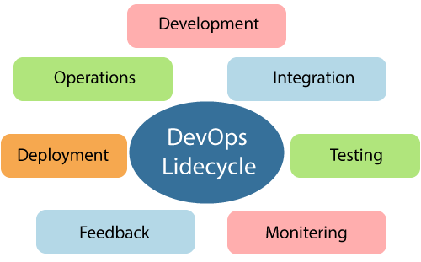
DevOps
What is DevOps?
DevOps describes a culture and set of processes that bring development and operations teams together to complete software development.
DEVOPS LIFE CYCLE-

Slide 2
Continuous Development- In the first phase of DevOps lifecycle, you should plan your application objectives that must be delivered to the customer. It includes activities like code generation and putting the same to the next phase.
Continuous Integration- Plan Tests and Build the product
Continuous Testing-Verify the product for actual usage in a live environment
Continuous Monitoring- Monitor the product output and find the problem areas
Continuous Feedback-improvise the current product and helps to release new versions quickly
Continuous Deployment- Ensures product is deployed with maximum accuracy
Continuous Operations- Automate release process with shorter development cycles

